Slide 1
Minimal APIs + HTMX
Devolve Web Apps Back To Web 1.0

Slide 2


Slide 3
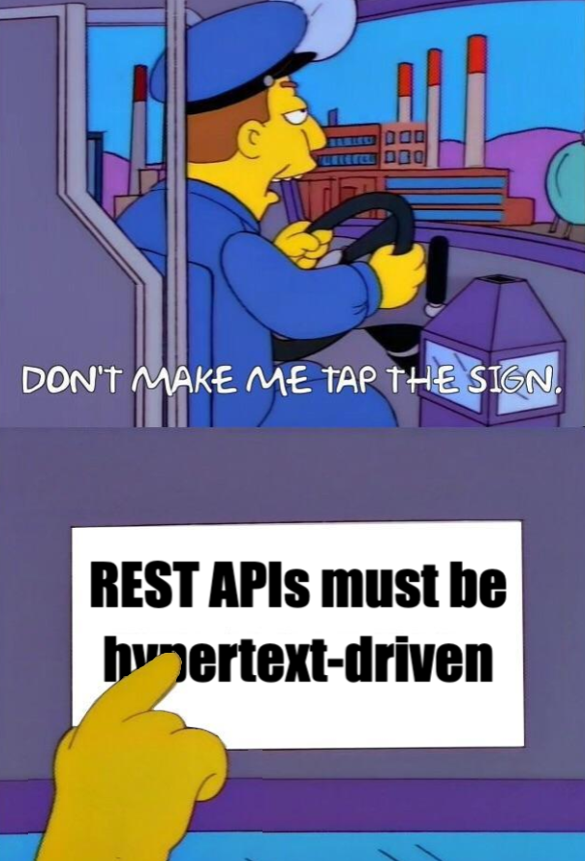
RESTless APIs
There is nothing wrong with JSON APIs
JSON is not a hypertext
Hypermedia is more than just status codes and
HTTP verbs
JSON APIs are RPC calls
Notes:
(2) In 1999, Roy Fielding, creator of the term REST was defining the web as it existed at the time - “surfing” the web was just HTML being exchanged over HTTP.
(2) The REST specification as described was written in 1999 - before JSON was even created and long before it was widely adopted
(3) The crux of REST is Hypermedia As The Engine of Application State (HATEOAS)
(4) Because the client and server are coupled together, this is more akin to an RPC call where the client needs to have additional knowledge about the resource it is working with.

Slide 4
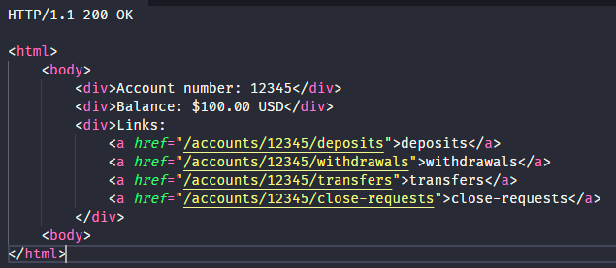
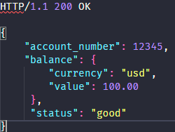
Hypermedia As The Engine Of Application State (HATEOAS)
What is a bank account?
Plz help 😭
What actions can I perform?
Notes:
REST has many constraints and concepts within it but the uniform interface constraint is the most important (HATEOAS).
The crucial difference between these two responses, and why the HTML response is RESTful, but the JSON response is not, is this: The HTML response is entirely self-describing.
Breakdown
The hypermedia client does not know what a bank account is, what a balance is, etc. It simply knows how to render a hypermedia (HTML)
The hypermedia client knows nothing about the API end points except via URLs and hypermedia controls (links and forms) discoverable within the HTML itself.
If the state of the resource changes (for example, it overdrafts), then the html response changes to show the new set of actions available.
The client renders this new html, totally unaware of what overdraft means.
There have been attempts made to shove HATEOAS into JSON. This is okay, because things that work are valued over dogmatic purity, but still require coupling on the client.

Slide 5
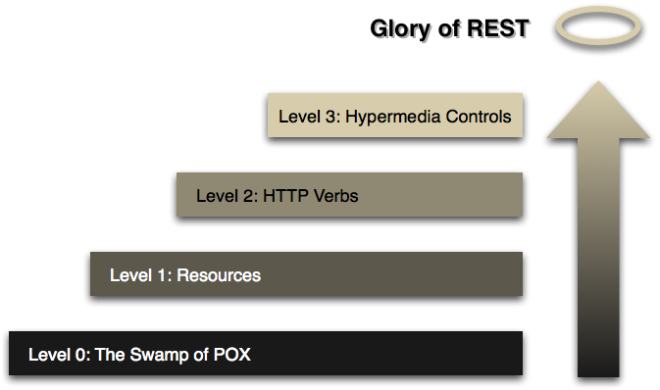
RESTful Maturity Model
credit to Martin Fowler https://martinfowler.com/articles/richardsonMaturityModel.html
Notes:
Swamp of POX - 2008, (Plain Old XML)

Slide 6
Learn More About Hypermedia
htmx.org/essays
hypermedia.systems/book/contents/
Notes:
There’s a long history of how we got to the point where APIs that are obviously not RESTful started being called RESTful.

Slide 7


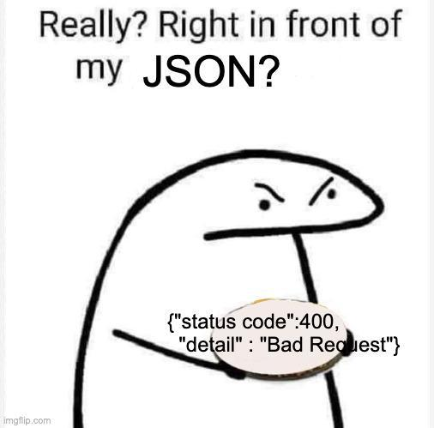
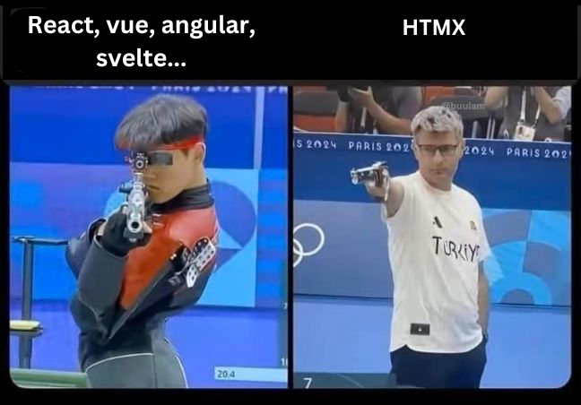


Notes:
Carson Gross (plus a lot of other contributors)

Slide 8
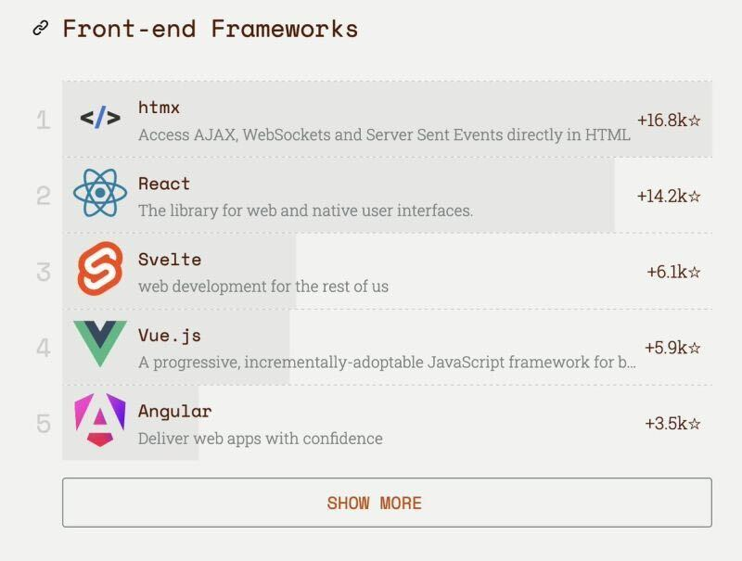

Slide 9
HTMX Motivations
Why should only a `<a`> and `<form>` be able to make HTTP requests?
Why should only click and submit events trigger them?
Why should only GET and POST methods be available?
Why should you only be able to replace the entire screen?
Notes:
(4) In my opinion, this is _really_ what is desired in the SPA world. The ability to replace parts on the screen without having to do a complete server-side refresh. “Traditional Web 1.0”

Slide 10
No Blazor Web (SSR)
Htmx.js is ~14KB. Blazor Web is ~200KB
Loading content dynamically based on viewport
Loading content dynamically based on a trigger
Loading content dynamically somewhere on the page (out of band)
Changing pages in Blazor SSR doesn’t bring you to the top of the page if both pages have below-the-fold content and you have scrolled down.
Dynamically loading javascript scripts is janky
Managing render modes is complicated
I like group-by-feature folders and including interactivity requires a .Client project

Slide 11
DEMO

Slide 12
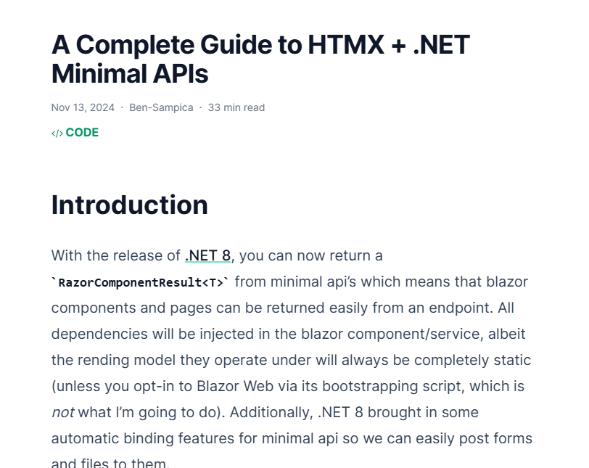
Try It Yourself
bensampica.com/post/minimalapihtmx

Slide 13
Questions?

